Slide 1
Logic Synthesis toolbox

Slide 2
Lecutre-2 BDD & SAT Solver

Slide 3
Table of Contents
Bool tree
Binary Decision Diagram
Circuit equivalent check (CEC)
8-queens
The application of SAT Solver

Slide 4
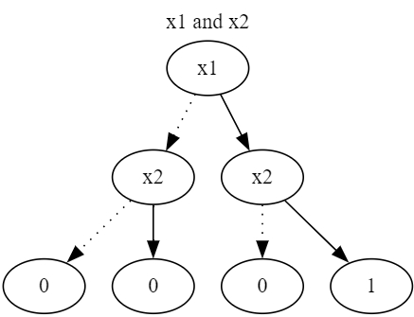
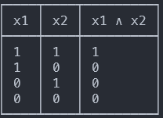
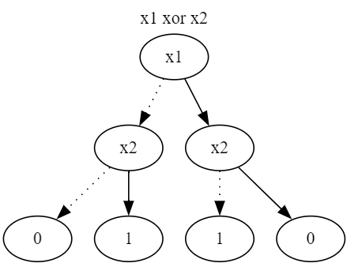
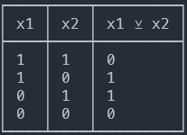
Truth Table and Bool Tree

Slide 5
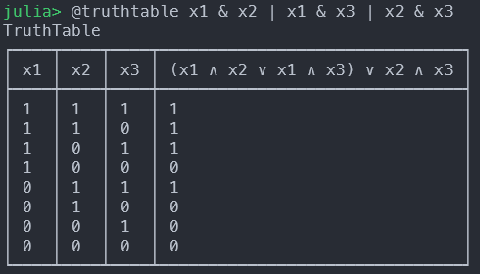
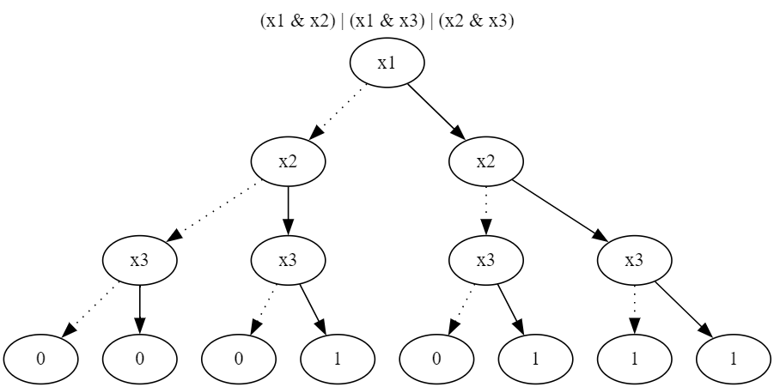
Majority gate (MAJ3)

Slide 6
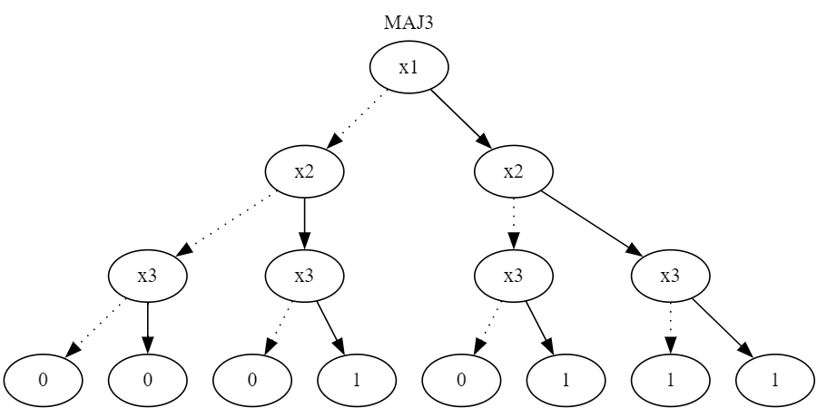
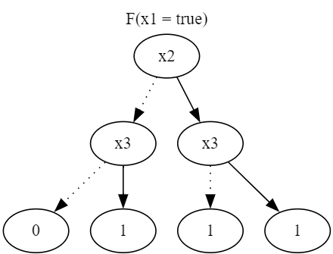

Shannon’s decomposition
$F=xF_{x}+\overline{x}F_{\overline{x}}$
Decompose complex logic:
$F=x_{1}F_{x_{1}}+\overline{x_{1}}F_{\overline{x_{1}}}=x_{1}⋅\left(x_{2}+x_{3}\right)+\overline{x1} (x_{2}{⋅x}_{3})$

Slide 7
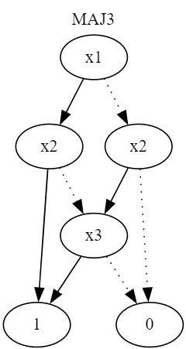
Reduced Ordered Binary Decision diagram

Slide 8
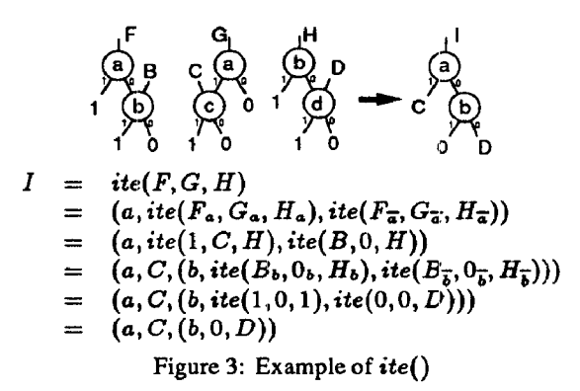
If-Then-Else operator (MUX)
$ite\left(F,G,H\right)=F∙G+\overline{F}∙H$
*ROBDD is a canonical representation

Slide 9

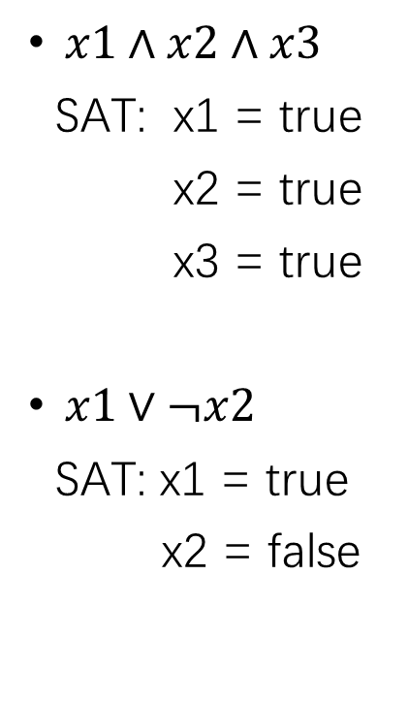
Boolean satisfiability problem (SAT)
$x1∧x2∧x3$
SAT: x1 = true
x2 = true
x3 = true
$x1∨¬x2$
SAT: x1 = true
x2 = false
$x1∧¬x1$
UNSAT
($x1⊕x2)∧x1∧x2$
UNSAT

Slide 10
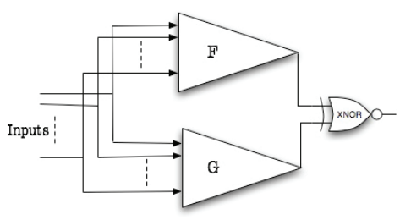
Equivalent check: Miter Circuit

Slide 11
Reference
BDD:
Andersen, Henrik Reif. "An introduction to binary decision diagrams." Internet, September (1996).
Brace, Karl S., Richard L. Rudell, and Randal E. Bryant. "Efficient implementation of a BDD package." Proceedings of the 27th ACM/IEEE design automation conference. 1991.
Cudd manual
SAT:
如何用一行代码打败修炼三十年的高数老师 – 蒋炎岩 NJU
Z3 Python API
Programming Z3 manual

